Slide 1
Accessible and Inclusive Classrooms
TheCC.Page/THEE-1

Slide 2

PAUSE
REWIND
REPLAY

Slide 3
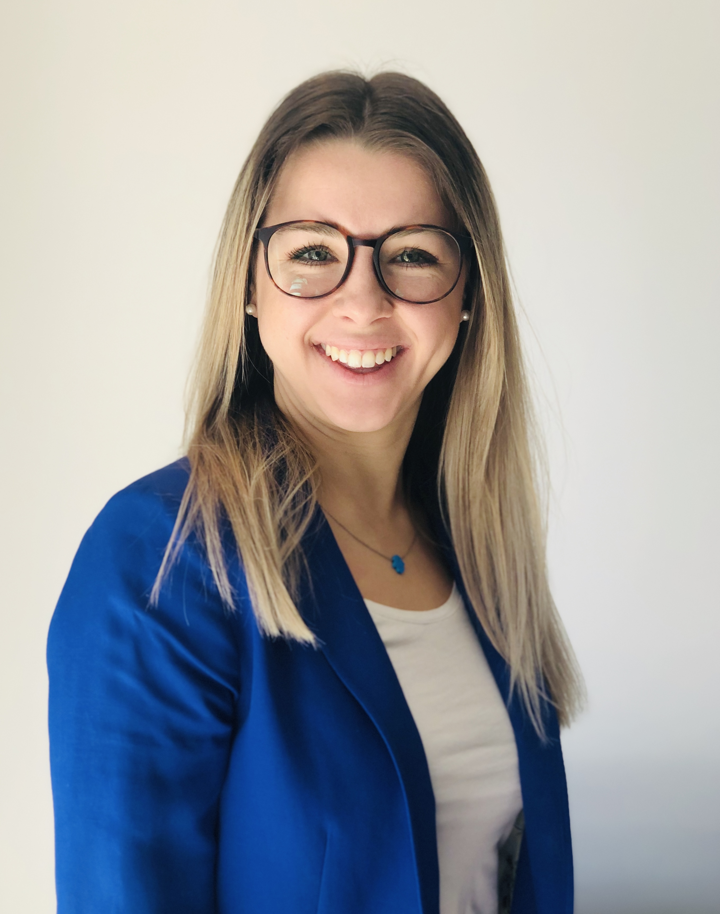
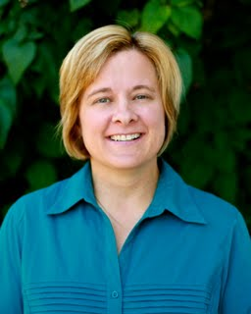
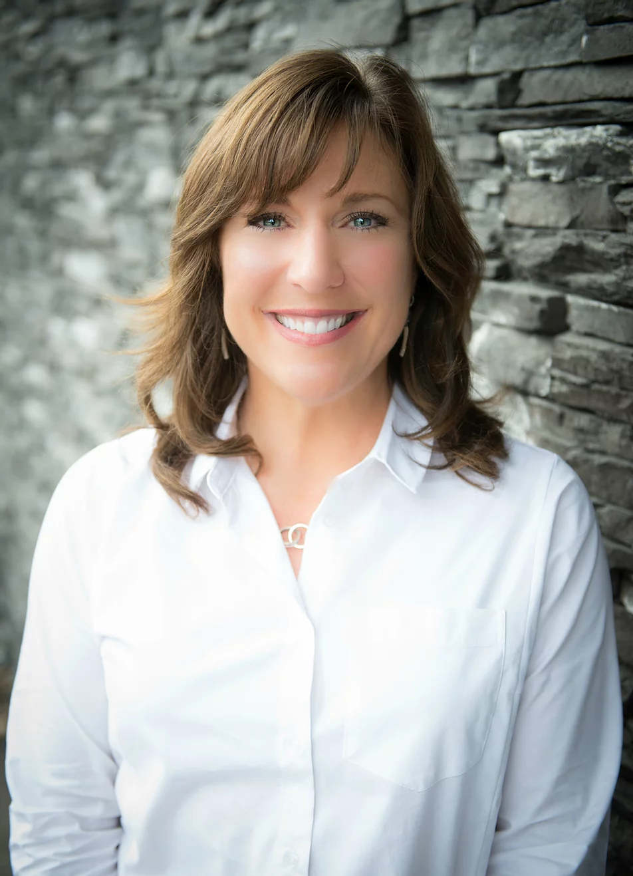
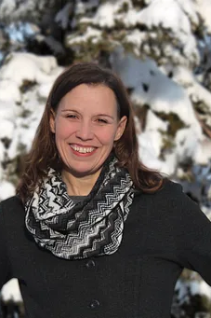

Your Team for Today
Alexandra Le Marquand
Montreal, Quebec
@AlexaLeMar
Tammy Lind
Milwaukee, WI
@TamL17
Samantha Woods
Calgary, Alberta
@samantha4better
Michelle Armstrong
Calgary, Alberta
@armstrongedtech

Slide 4
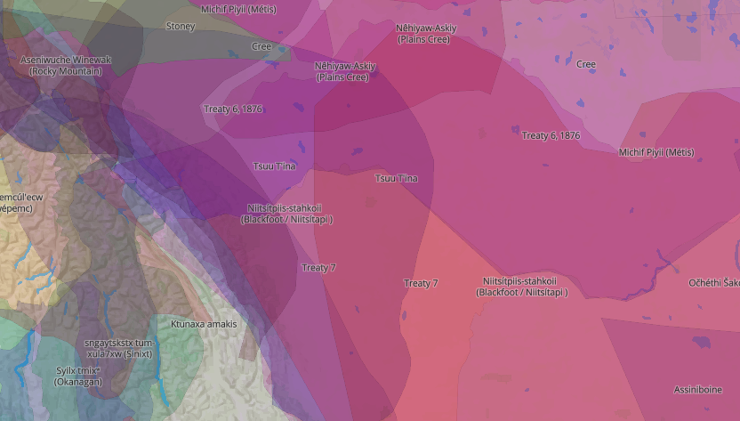
I would like to take this opportunity to acknowledge that I am joining from the traditional territories of the people of the Treaty 7 region in Southern Alberta which includes the Blackfoot, Siksika, Piikani and Kainai, Tsuut’ina and Stoney Nakoda Nation. Calgary is also the home of the Métis Nation of Region 3.
Land Acknowledgement - native-land.ca

Slide 5
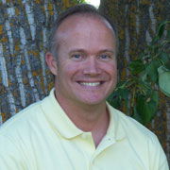

THANK YOU!
Brett Bowers
https://thee.ca

Slide 7
Today’s Plan
Welcome
Creating accessible presentations
Exploring accessible documents
Producing accessible content using Dictation

Slide 8
We Want To Hear From You
thecc.page/myanswer
Let’s Practice

Slide 9
Welcome to Accessibility

Slide 10
Accessibility Tools at Microsoft
Read Aloud and Word Highlighting | OneNote Desktop | OneNote Web | OneNote App | OneNote iOS | OneNote Mac | Word (online) | Word (desktop app) | Word Mac | Word iPad | Outlook (online) | Outlook (desktop app) | Teams | Flipgrid | Flipgrid iOS | Flipgrid Android | White board | Forms | Minecraft Edu | Office Lens | Edge browser
Spacing and character font | OneNote Desktop | OneNote Web | OneNote App | OneNote iOS | OneNote Mac | Word (online) | Word (desktop app) | Word Mac | Word Ipad | Outlook (online) | Outlook (desktop app) | Teams | Flipgrid | Flipgrid iOS | Flipgrid Android | White board | Forms | Minecraft Edu | Office Lens | Edge browser
Page color | OneNote Desktop | OneNote Web | OneNote App | OneNote iOS | OneNote Mac | Word (online) | Word (desktop app) | Word Mac | Word iPad | Outlook Web | Teams | Flipgrid | Flipgrid iOS | Flipgrid Android | White board | Forms | Minecraft Edu | Office Lens | Edge Browser
Syllables | OneNote Desktop | OneNote Web | OneNote App | OneNote iOS | OneNote Mac | Word (online) | Word (desktop app) | Outlook (online) | Teams | Flipgrid | Flipgrid iOS | Flipgrid Android | White board | Forms | Minecraft Edu
Line focus | OneNote Desktop | OneNote Web | OneNote App | OneNote iOS | OneNote Mac | Word (online) | Word (desktop app) | Outlook (online) | Teams | Flipgrid | Flipgrid iOS | Flipgrid Android | White board | Forms | Minecraft Edu
Grammatical category | OneNote Desktop | OneNote Web | OneNote App | OneNote iOS | OneNote Mac | Word (online) | Outlook (online) | Teams | Flipgrid | Flipgrid iOS | Flipgrid Android | White board | Forms | Minecraft Edu
Translation | OneNote Web | OneNote App | OneNote iOS | OneNote Mac | Word (online) | Outlook (online) | Teams | Flipgrid | Flipgrid iOS | Flipgrid Android | White board | Forms | Minecraft Edu
Visual dictionary | OneNote Web | OneNote App | OneNote iOS | OneNote Mac | Word (online) | Outlook (online) | Teams | Flipgrid | Flipgrid iOS | Flipgrid Android | White board | Forms | Minecraft Edu
Dictation | OneNote Desktop | OneNote App | OneNote Web | Word (online) | Word (online) | Outlook (desktop app) | PPT (desktop app) | PPT (en ligne) | Windows 10
Mathematics and formulas | OneNote Web | OneNote App | OneNote iOS | OneNote Mac | Word (online) | Word (desktop app) | PPT (desktop app)

Slide 11
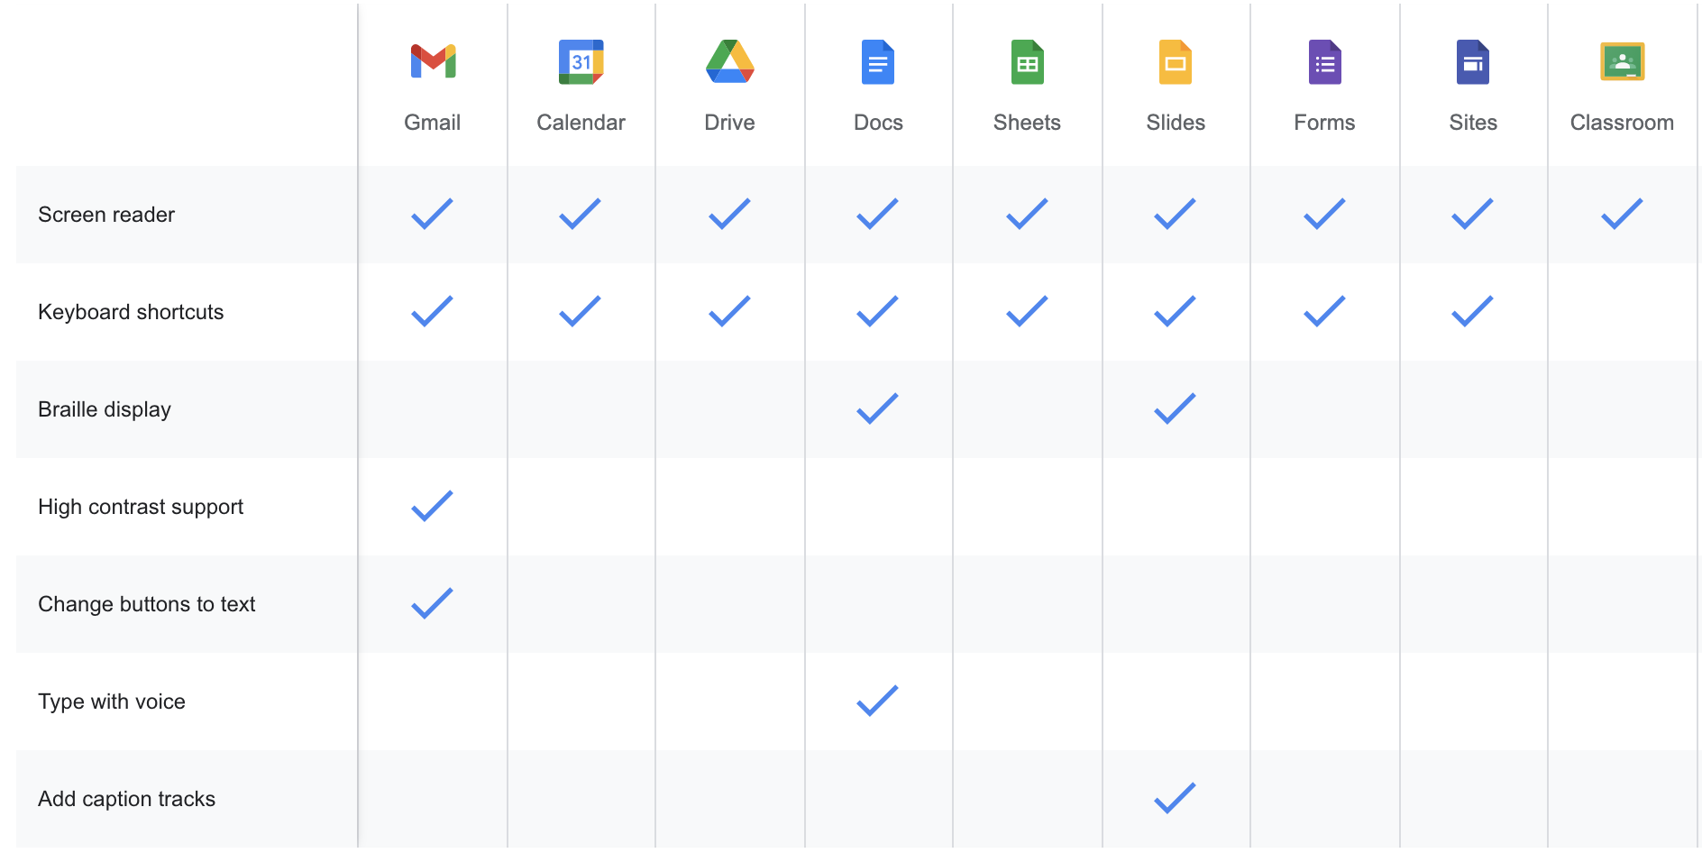
Accessibility Tools For Google Workspace for EDU

Slide 12
What does that mean?
We need to adopt methods that promote academic success for ALL, especially including those students with learning differences

Slide 13
Create a foundation for students
Inclusive education tools provide more students with personalized access to their curriculum, optimize teachers' time and improve learning outcomes.
Students develop their full potential and gain independence
Teachers have the tools to engage each student in their learning
Schools build their reputations as positive places to promote equity and inclusion
Notes:
Parler du rôle important de l’enseignant dans l’apprentissage scolaire et le besoin de nous adapter pour les aider à réussir.

Slide 14
Promoting independent learning
Mental Health
Learning
Visual
Hearing
Mobility
Neurodiversity
Dyslexia
Dysgraphia
Dyscalculia
Vision problems
Blind
Color blind
Deaf
Hard of Hearing
Cerebral palsy
Muscular dystrophy
Amputation
Autism
ADD/ADHD
Epilepsy
Anxiety
Depression

Slide 15
CREATING ACCESSIBLE PRESENTATIONS

Slide 16
PowerPoint
Subtitling
Rehearse with a coach
Online version

Slide 17
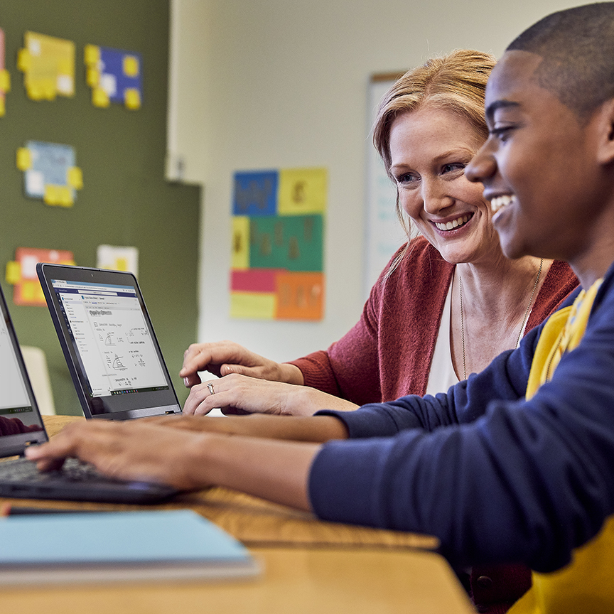
Improve your communication with Presenter Coach in PowerPoint
Delivering presentations with confidence in front of others is essential not only in a school setting but also in the workplace.
Based on best practices and academic research, we've incorporated common tips and tricks into Presenter Coach to help teachers and students make presentations more effective.

Slide 18

Students “Rehearse with a Coach" with microphone
Receive advice on:
Rhythm: if you speak too fast/slow
Stutter Words: if you say too many words like: eh, um, ok etc. too often
Insensitive phrases: phrases that are biased towards people of different sex, disability, race,
Narrator: detect if you read too much what is written on the slide
At the end of each practice, you will receive a detailed report and tips for future presentations!
'Available only online version at the moment'

Slide 19
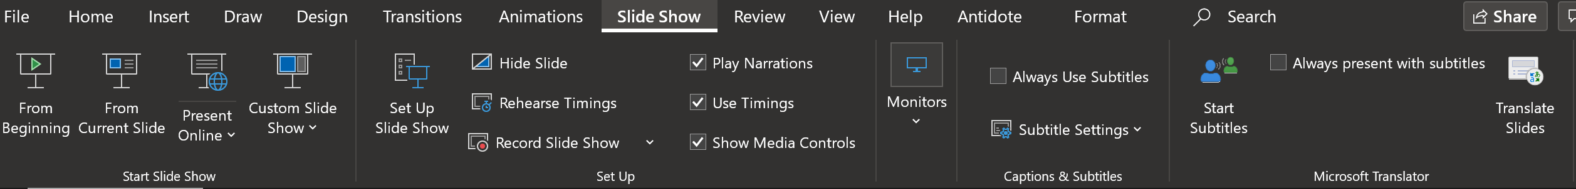
Screen Recording and Subtitling
Subtitling: Anyone can follow along on their own device to see the subtitles in front of them
Using the Microsoft Translator app
Recording your Slideshow: Film yourself presenting as well as your presentation at the same time and then save for students to review at a later date

Slide 20
Google Slides
Closed Caption
Voice Typing
Online version

Slide 21
Immersive Reader

Slide 22
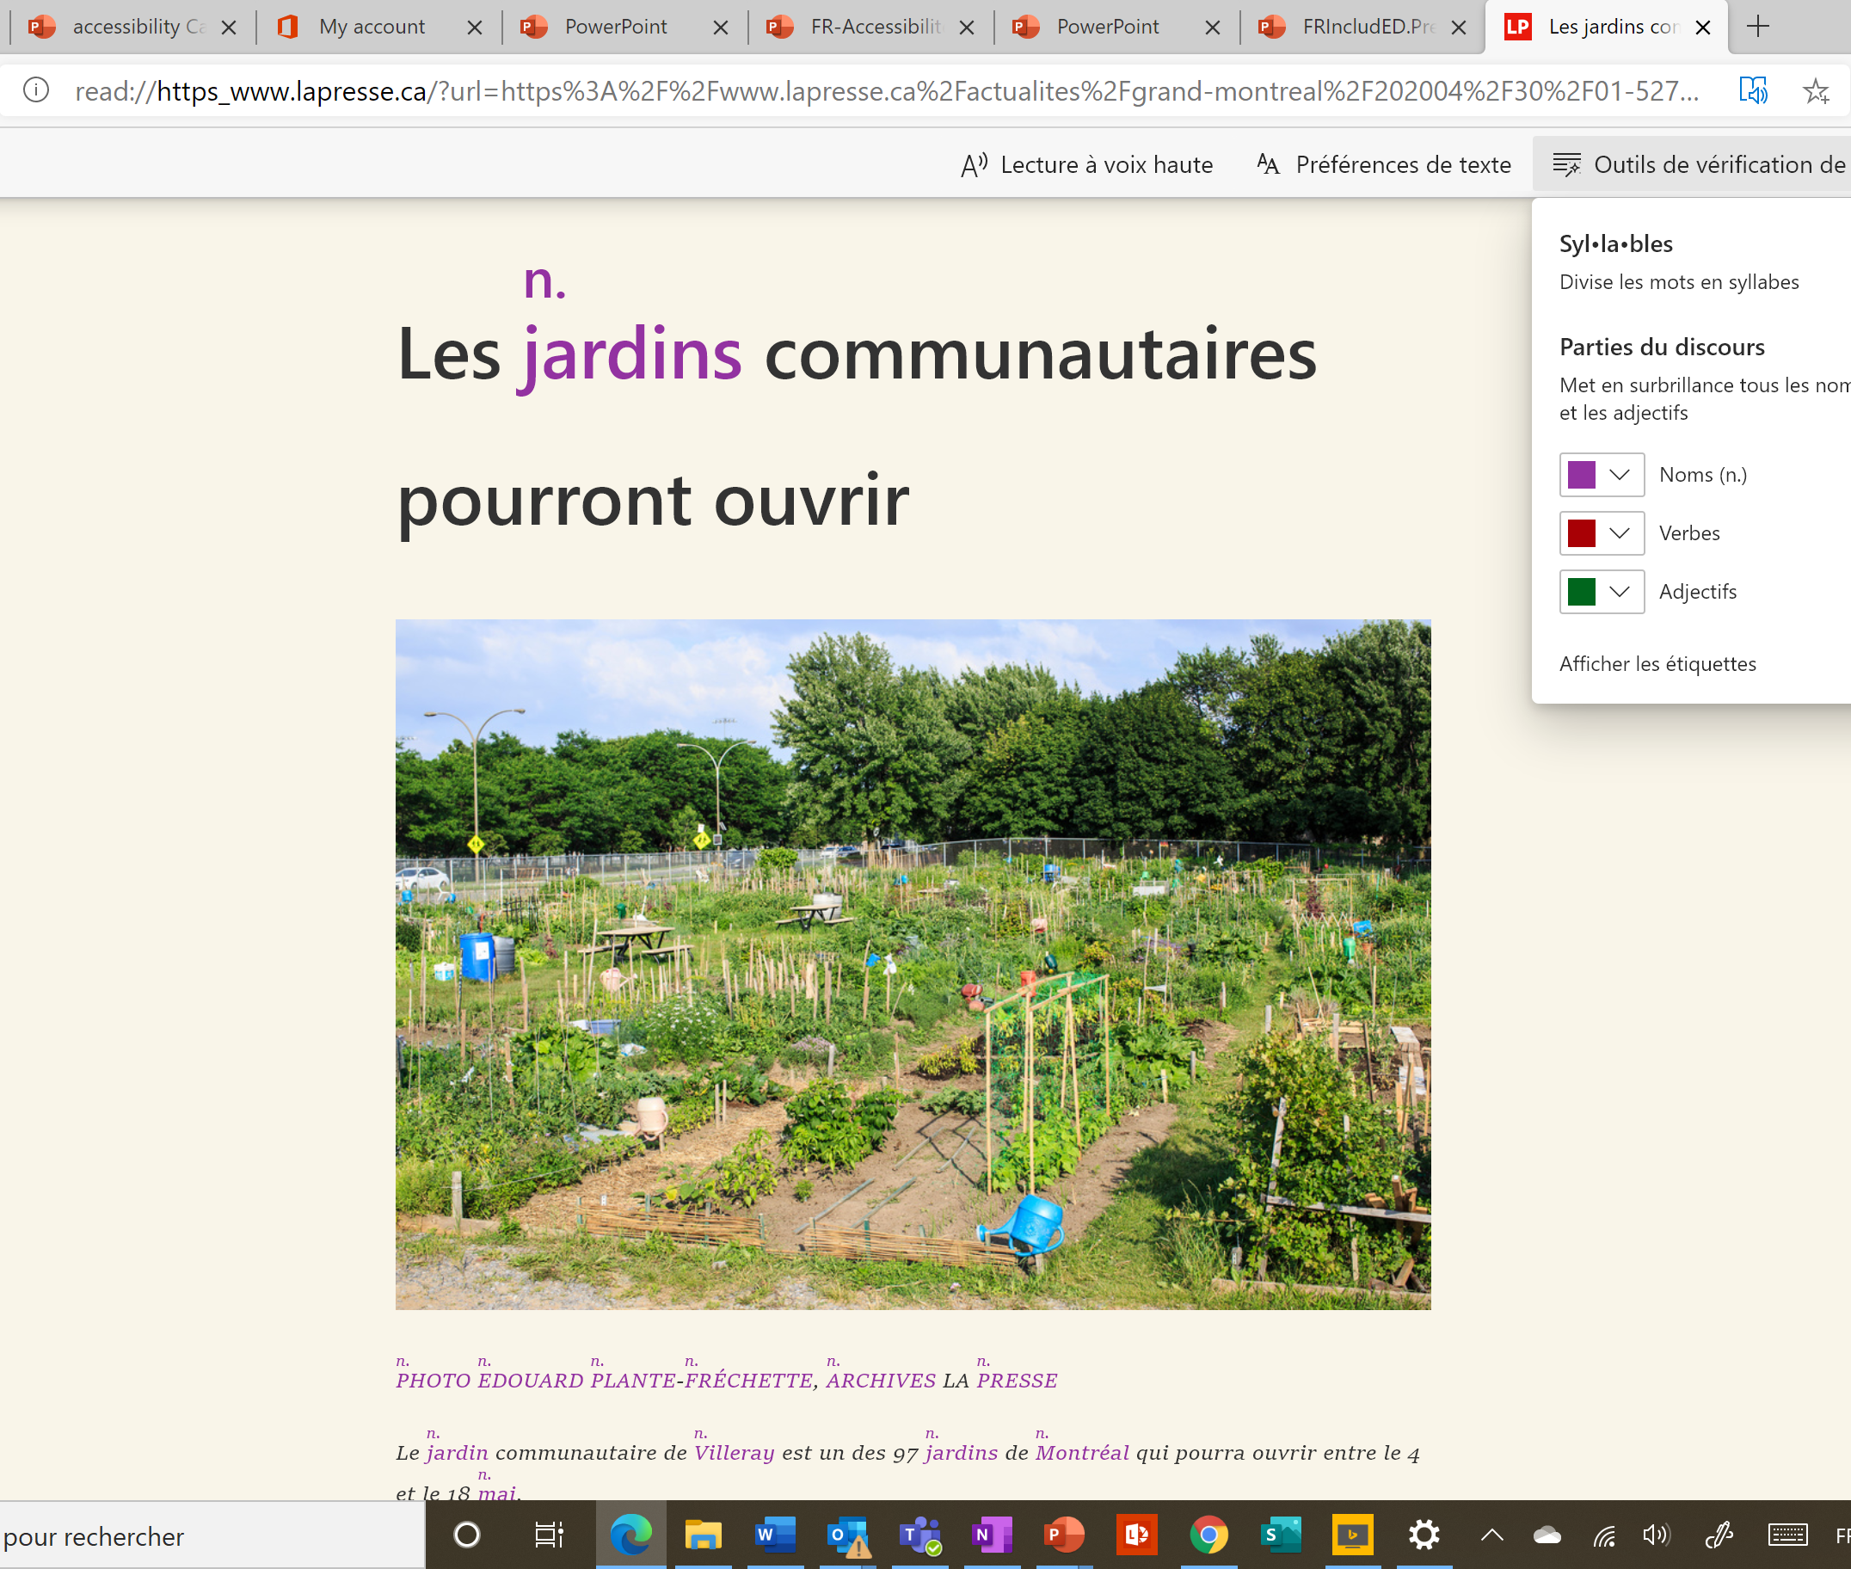
Microsoft Edge

Slide 23
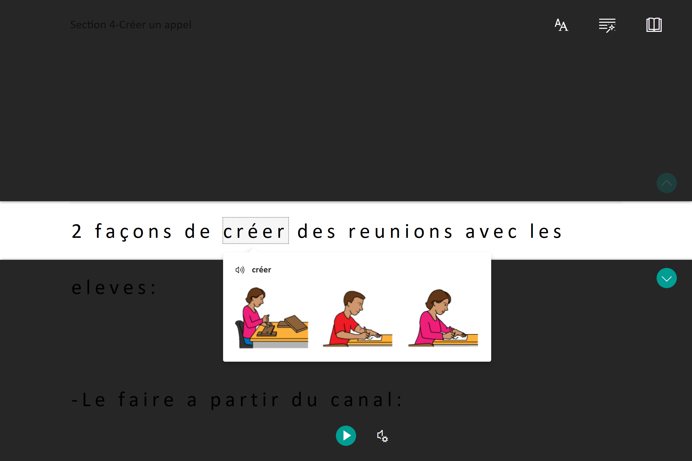
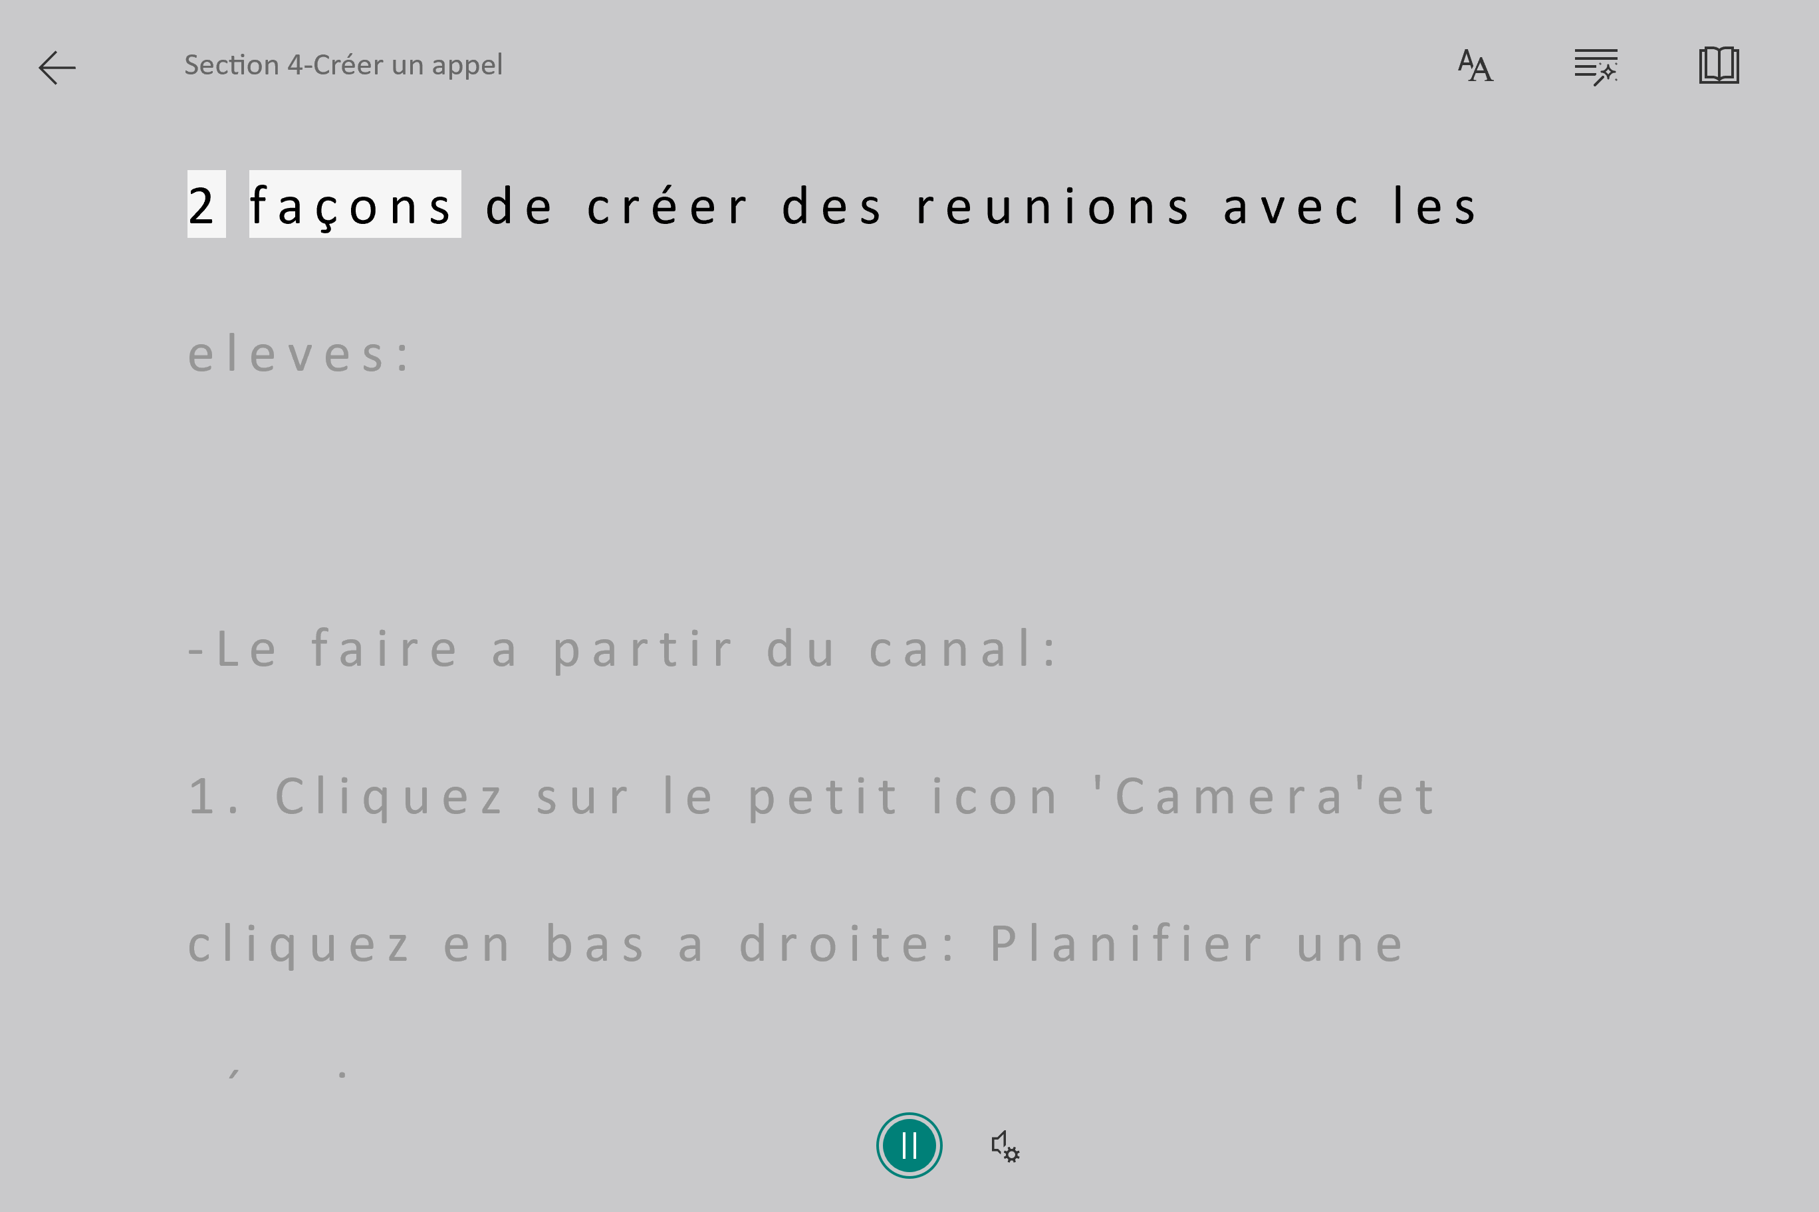
Word

Slide 24
Dictation

Slide 25
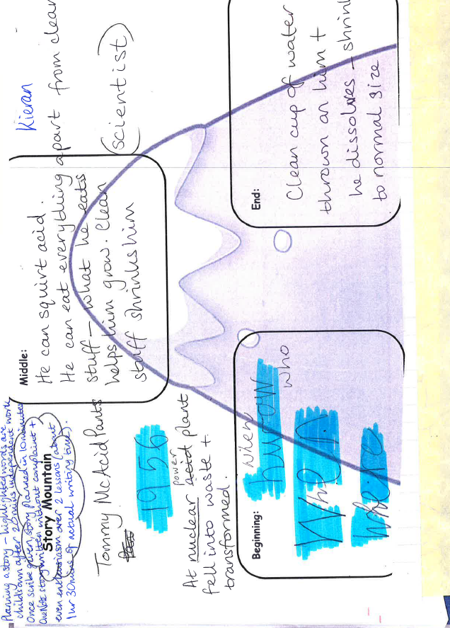
Picture of 9 year old old student writing sample
The draft sheet of a 9-year-old boy with a learning disability
(dyslexia).
Notes:
Comme vous le voyez, son écriture est illisible. Par contre, avec les outils dans One Note, regardez le prochain!

Slide 26
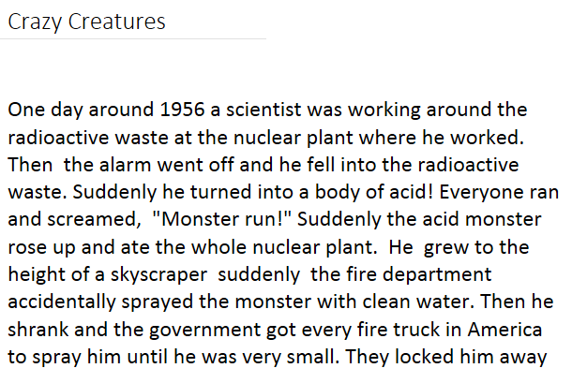
9 year old writing sample slide, after tool use
This same boy was able to complete the text below using OneNote.
Notes:
Quel élève veux toujours poser une question et attire l’attention du group? Maintenant, il peut le compléter seul et sans jugement de ses amis.
It is very difficult to develop the higher thinking skills needed for creative writing if you can’t write your thoughts down.

Slide 27
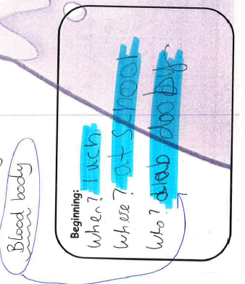
11 year old student writing sample
Here's an 11-year-old girl's draft.

Slide 28
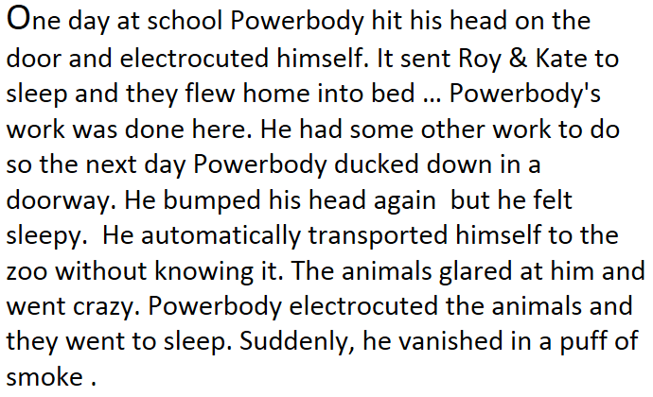
Picture of kids writing slide
That same girl there was able to write this with OneNote.

Slide 29
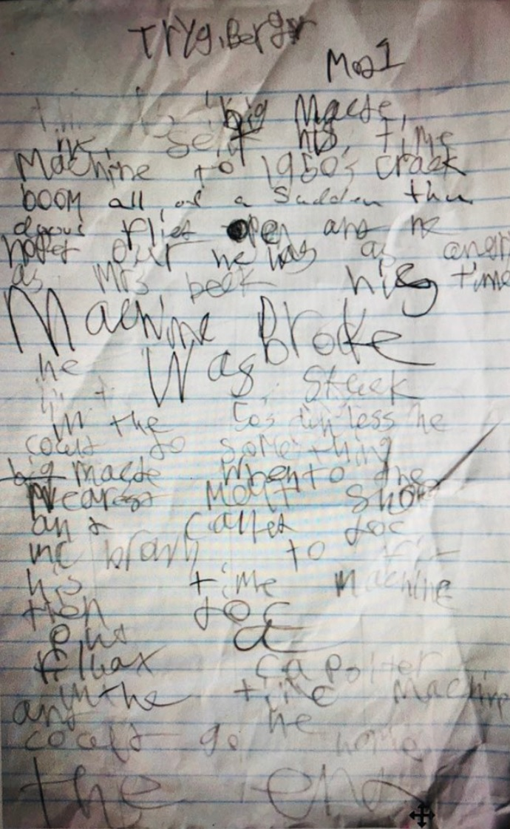
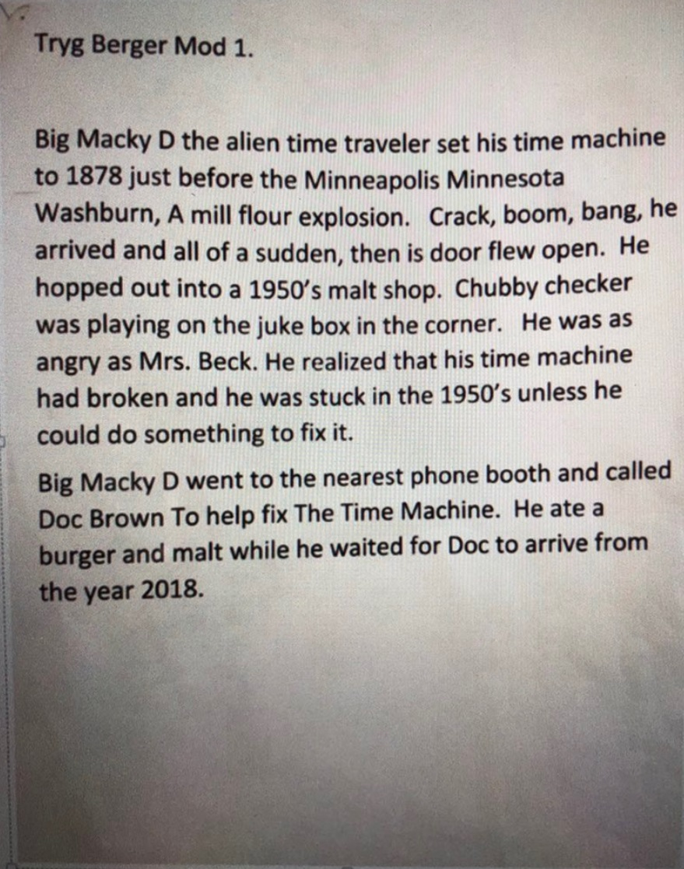
Picture of 7th grade student writing sample
Before and After a text of a student in Grade 8 with Dictation

Slide 30
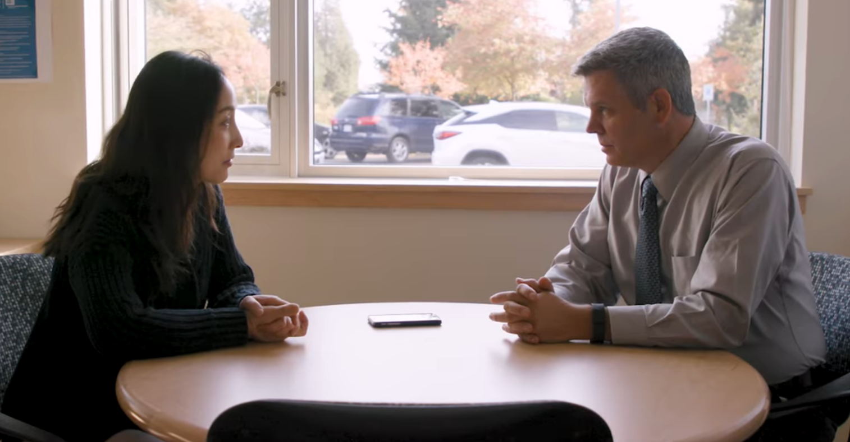

Microsoft Translator

Slide 31


Additional
Resources
Microsoft Accessibility
Share your ideas at User Voice.com
Microsoft Education Center
Accessibility PDF
Google Accessibility
Just For You!

Slide 32
Thank you!
Feedback: TheCC.Page/feedback
Support: help@cobblestonecollective.ca
Accessible and Inclusive Classrooms
TheCC.Page/THEE-1

